Slide 1


Mostafizur Rahman
December 2, 2023

Slide 2

Outline
Executive Summary
Introduction
Methodology
Results
Conclusion
Appendix

Slide 3
Executive Summary
Summary of methodologies
API Data Collection
Web Scraping for Data Acquisition
Data Wrangling and Cleaning
Exploratory Data Analysis using SQL
Data Exploration through Visualization
Interactive Visual Analytics with Folium
Machine Learning for Predictive Analysis
Summary of all results
Exploratory Data Analysis Insights
Screenshots of Interactive Analytics
Predictive Analytics Outcome

Slide 4
Introduction
Project background and context
Space X advertises Falcon 9 rocket launches on its website with a cost of 62 million dollars; other providers cost upward of 165 million dollars each, much of the savings is because Space X can reuse the first stage. Therefore, if we can determine if the first stage will land, we can determine the cost of a launch. This information can be used if an alternate company wants to bid against space X for a rocket launch. This goal of the project is to create a machine learning pipeline to predict if the first stage will land successfully.
Problems you want to find answers
What factors play a pivotal role in determining the success of a rocket landing?
How do various features interact to influence the success rate of a landing?
What operating conditions must be in place to ensure a successful rocket landing program?

Slide 5

Section 1

Slide 6

Methodology
Executive Summary
Data collection methodology:
Data was collected using SpaceX API and web scraping from Wikipedia
Perform data wrangling
One-hot encoding was applied to categorical features
Perform exploratory data analysis (EDA) using visualization and SQL
Perform interactive visual analytics using Folium and Plotly Dash
Perform predictive analysis using classification models
How to build, tune, evaluate classification models

Slide 7
Data Collection
Various methods were employed for data collection:
SpaceX API was utilized through a GET request to retrieve data.
The response content was decoded into JSON format using the .json() function and subsequently transformed into a pandas dataframe via .json_normalize().
Data cleaning processes were implemented, including the identification and handling of missing values.
Web scraping from Wikipedia using BeautifulSoup was conducted to obtain Falcon 9 launch records.
The goal was to extract launch records from an HTML table, parse the table, and convert the information into a pandas dataframe for subsequent analysis.

Slide 8
Data Collection - Scraping
Start
We applied web scraping to extract Falcon 9 launch records from a webpage using BeautifulSoup. Subsequently, we parsed the table and converted the retrieved information into a pandas dataframe.
The link to the notebook is M1.2.jupyter-labs-webscraping.ipynb
Web Scraping
Wikipedia with BeautifulSoup
Extract HTML Table
Parse HTML Table
Covert to DataFrame
End

Slide 9
Data Collection – SpaceX API
Start
We utilized a GET request to the SpaceX API to retrieve data, performed data cleaning on the acquired information, and conducted essential data wrangling and formatting.
The link to the notebook is M1.1.jupyter-labs-spacex-data-collection-api.ipynb
SpaceX API GET Request
Decode JSON & JSON to DataFrame
Check for Missing Values & Fill Missing Values
End

Slide 10

Data Wrangling
We Calculated the number of launches on each site
We Calculated the number and occurrence of each orbit
We Calculated the number and occurrence of mission outcome of the orbits
Create a landing outcome label from Outcome column
The link to the notebook is M1.3.labs-jupyter-spacex-Data wrangling.ipynb

Slide 11
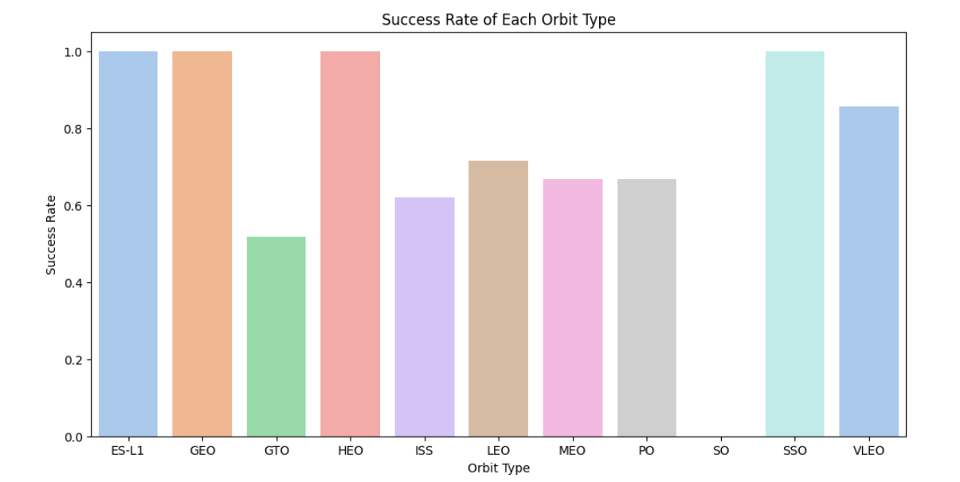
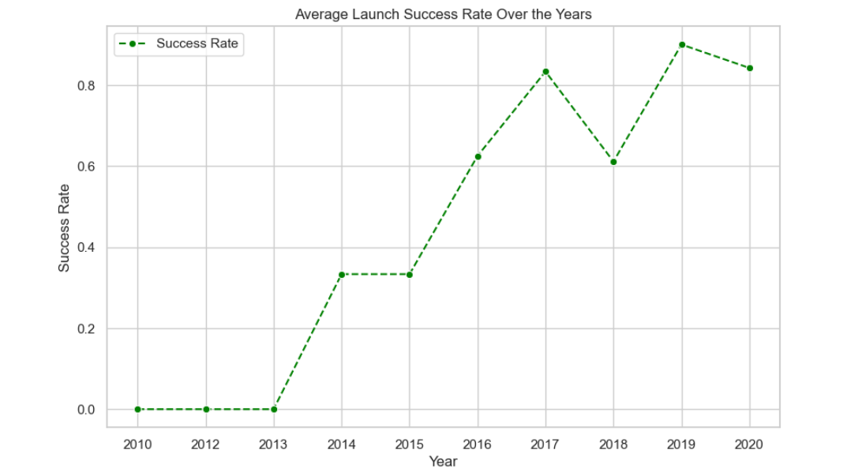
EDA with Data Visualization
Conducted an in-depth exploration of the data through visualizations examining relationships such as:
Flight number and launch site
Payload and launch site
Success rate of each orbit type
Flight number and orbit type
Launch success yearly trend
The link to the notebook is M1.3.labs-jupyter-spacex-Data wrangling.ipynb

Slide 12
EDA with SQL
Utilized Exploratory Data Analysis (EDA) with SQL to extract meaningful insights from the dataset. Formulated queries to unveil key information, such as:
Identifying unique launch site names in the space mission.
Determining the total payload mass carried by boosters launched by NASA (CRS).
Calculating the average payload mass carried by booster version F9 v1.1.
Analyzing the total number of successful and failed mission outcomes.
Investigating failed landing outcomes on drone ships, including details on booster versions and launch site names.
The link to the notebook is M2.1.jupyter-labs-eda-sql-coursera_sqllite.ipynb

Slide 13
Build an Interactive Map with Folium
• Geospatial Visualization: Marked all launch sites on a folium map, incorporating map objects like markers, circles, and lines to signify the success or failure of launches at each site.
• Feature Assignment: Assigned launch outcomes (failure or success) to classes 0 and 1, with 0 representing failure and 1 representing success.
• Success Rate Identification: Utilized color-labeled marker clusters to pinpoint launch sites with relatively high success rates.
• Proximity Analysis: Calculated distances between launch sites and their surroundings, addressing questions such as:
- Are launch sites situated near railways, highways, and coastlines?
- Do launch sites maintain a specific distance from cities?
The link to the notebook is M3.1.lab_jupyter_launch_site_location.ipynb

Slide 14
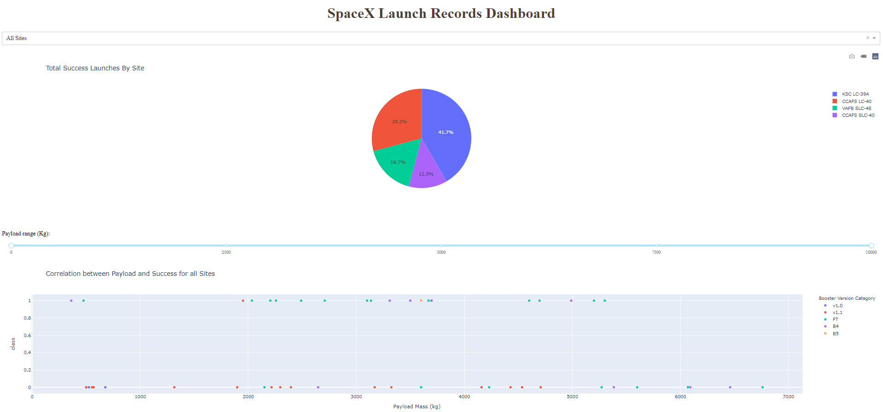
Build a Dashboard with Plotly Dash
• Developed an interactive dashboard using Plotly Dash.
• Created informative visualizations, including:
- Pie charts illustrating the success and failure percentages for specific sites.
- Scatter graphs depicting the relationship between Outcome and Payload Mass (Kg) for various booster versions.
• The link to the notebook is M3.2.Build a Dashboard.ipynb

Slide 15
Predictive Analysis (Classification)
Employed numpy and pandas for data loading, transformation, and splitting into training and testing sets.
Constructed diverse machine learning models, optimizing hyperparameters through GridSearchCV.
Evaluated models based on accuracy, continually enhancing performance through feature engineering and algorithm tuning.
Identified the most effective classification model.
The link to the notebook is M4.1.SpaceX_Machine_Learning_Prediction_Part_5.jupyterlite.ipynb

Slide 16
Results
Exploratory data analysis results
Interactive analytics demo in screenshots
Predictive analysis results

Slide 17

Section 2

Slide 18
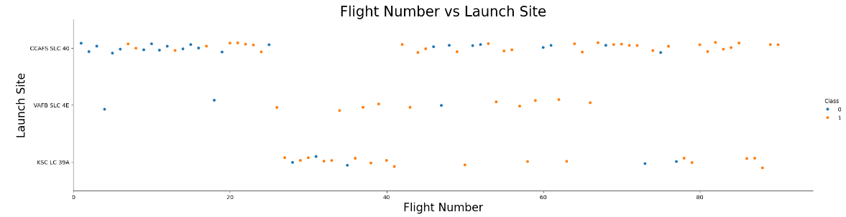
From the plot, we found that the larger the flight amount at a launch site, the greater the success rate at a launch site.
Flight Number vs. Launch Site

Slide 19
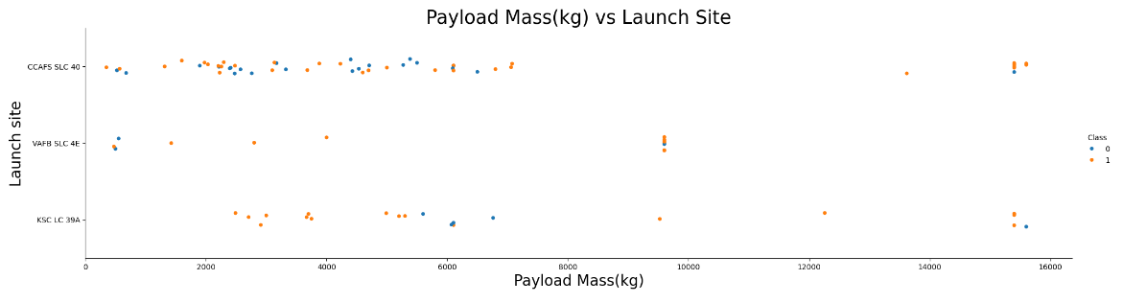
Payload vs. Launch Site
The greater the payload mass for launch site CCAFS SLC 40 the higher the success rate for the rocket.

Slide 20
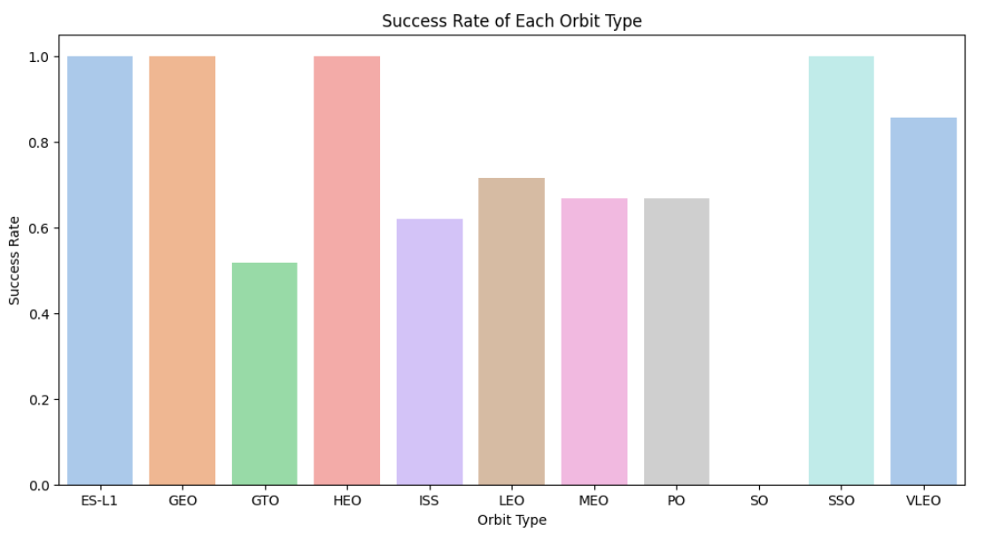
Success Rate vs. Orbit Type
From the plot, we can see that ES-L1, GEO, HEO, SSO, VLEO had the most success rate.

Slide 21
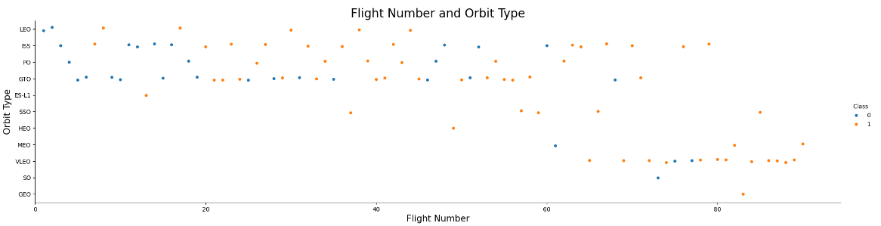
Flight Number vs. Orbit Type
The plot below shows the Flight Number vs. Orbit type. We observe that in the LEO orbit, success is related to the number of flights whereas in the GTO orbit, there is no relationship between flight number and the orbit.

Slide 22
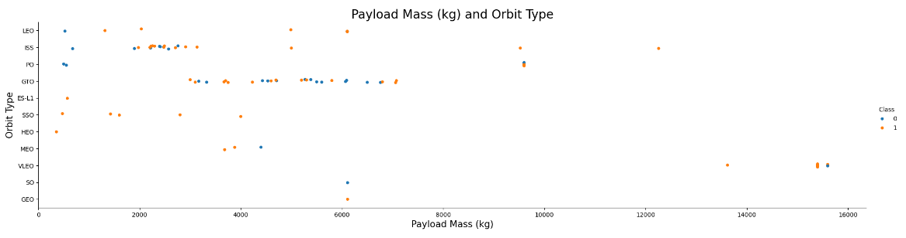
Payload vs. Orbit Type
We can observe that with heavy payloads, the successful landing are more for PO, LEO and ISS orbits.

Slide 23
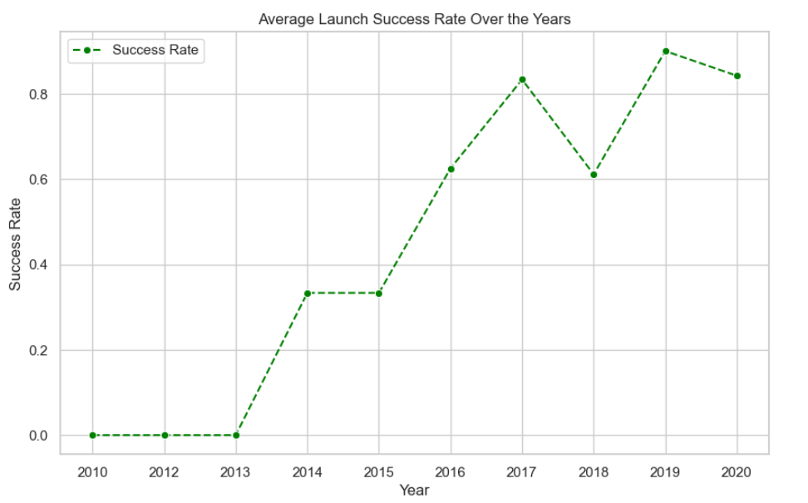
From the plot, we can observe that success rate since 2013 kept on increasing till 2020.
Launch Success Yearly Trend

Slide 24
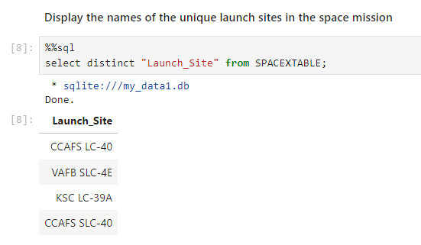
All Launch Site Names
We used the key word DISTINCT to show only unique launch sites from the SpaceX data.
24

Slide 25
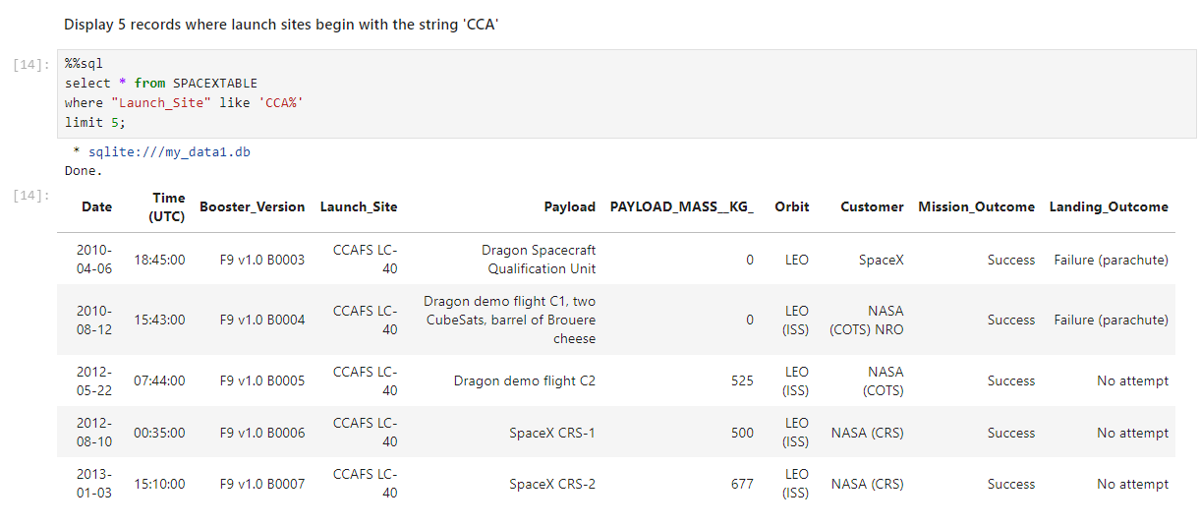
Launch Site Names Begin with 'CCA'
We used the query below to display 5 records where launch sites begin with `CCA`

Slide 26
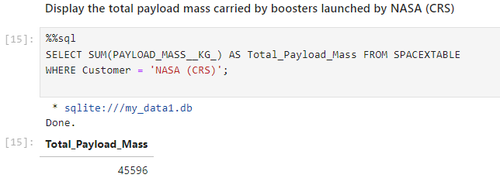
Total Payload Mass
We calculated the total payload carried by boosters from NASA as 45596 using the query below.

Slide 27
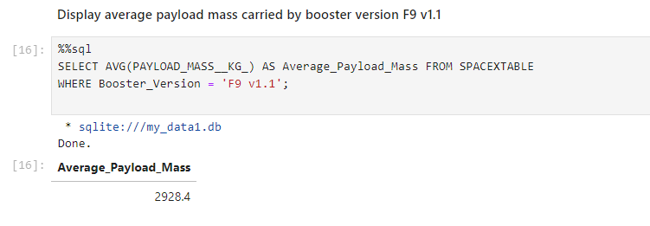
Average Payload Mass by F9 v1.1
We calculated the average payload mass carried by booster version F9 v1.1 as 2928.4

Slide 28
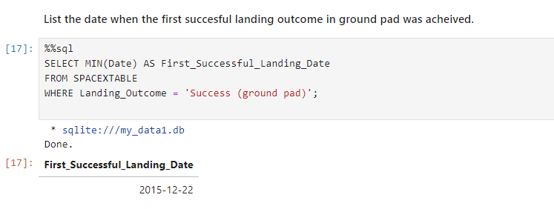
First Successful Ground Landing Date
We observed that the dates of the first successful landing outcome on ground pad was 22nd December 2015

Slide 29
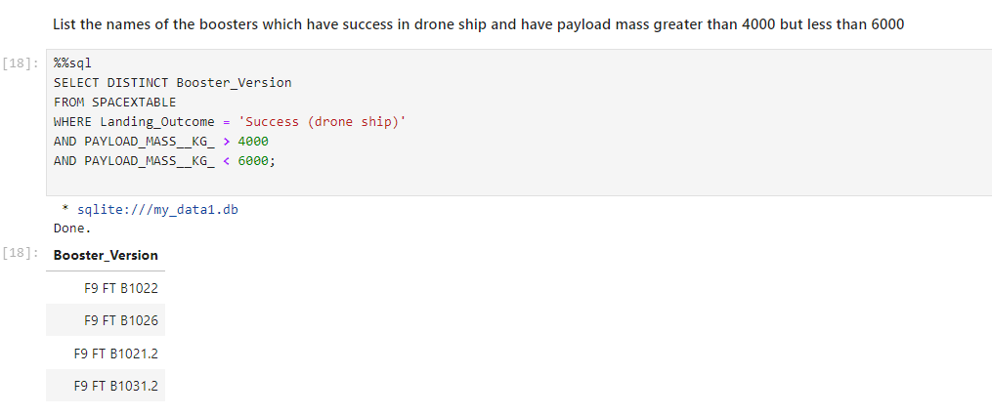
Successful Drone Ship Landing with Payload between 4000 and 6000
We used the WHERE clause to filter for boosters which have successfully landed on drone ship and applied the AND condition to determine successful landing with payload mass greater than 4000 but less than 6000

Slide 30
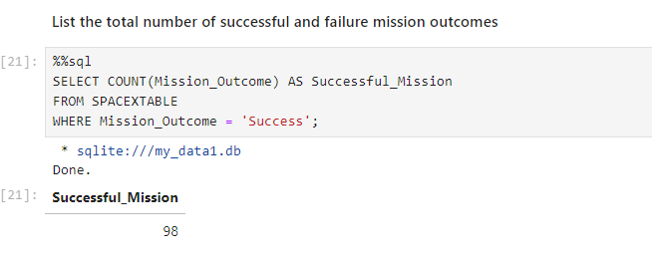
Total Number of Successful and Failure Mission Outcomes
We observed that there were total 98 successful mission.

Slide 31
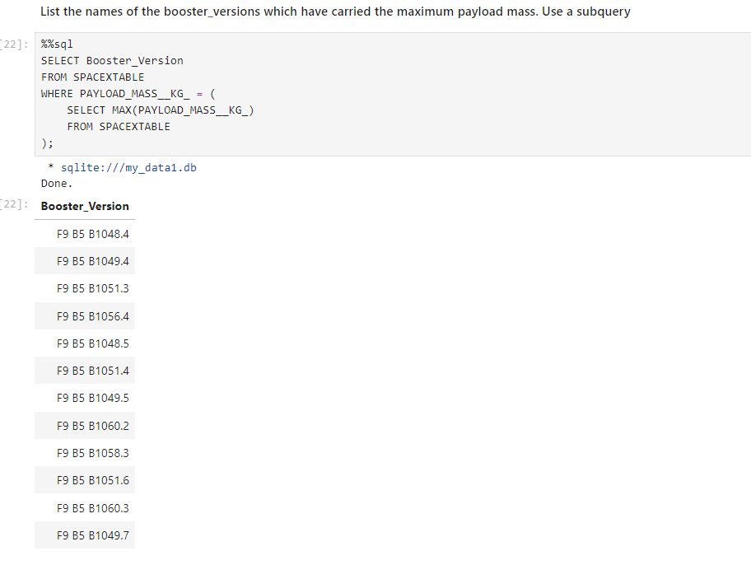
Boosters Carried Maximum Payload
We determined the booster that have carried the maximum payload using a subquery in the WHERE clause and the MAX() function

Slide 32
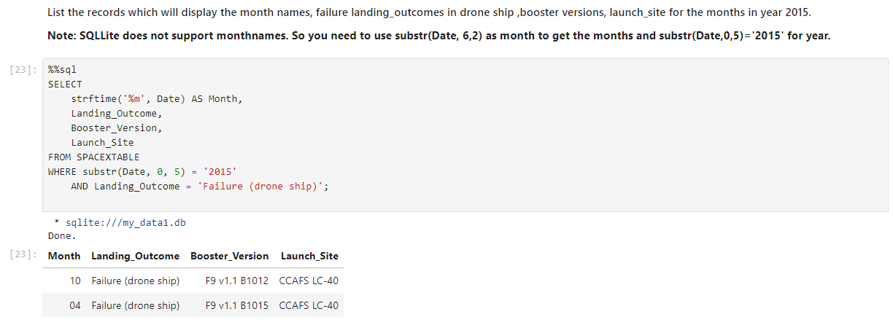
2015 Launch Records
We used substr() function to get months and year.

Slide 33
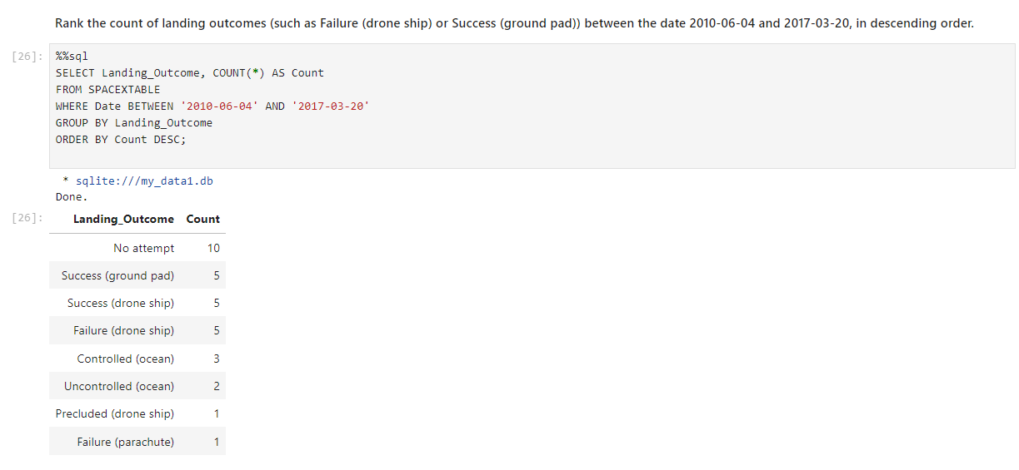
Rank Landing Outcomes Between 2010-06-04 and 2017-03-20
We applied the GROUP BY clause to group the landing outcomes and the ORDER BY clause to order the grouped landing outcome in descending order.

Slide 34

Section 3

Slide 35
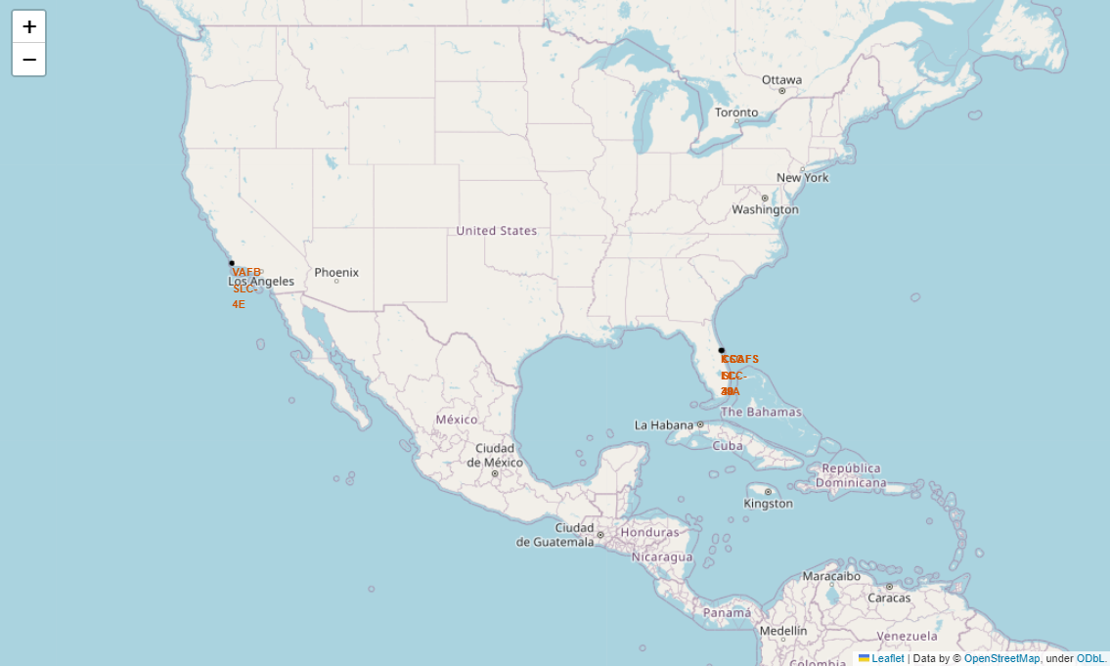
Global Map Markers for All Launch Sites
The SpaceX launch sites are prominently located along the coastlines of the United States, specifically in California and Florida.

Slide 36
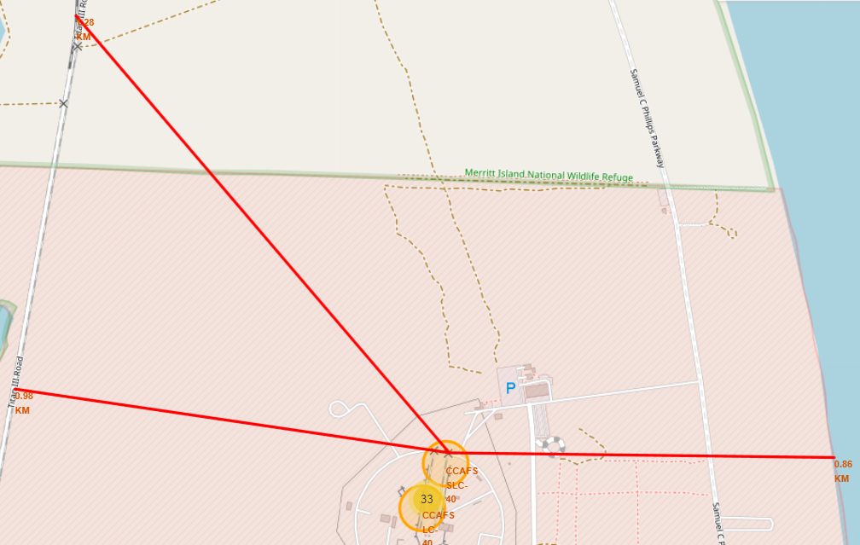
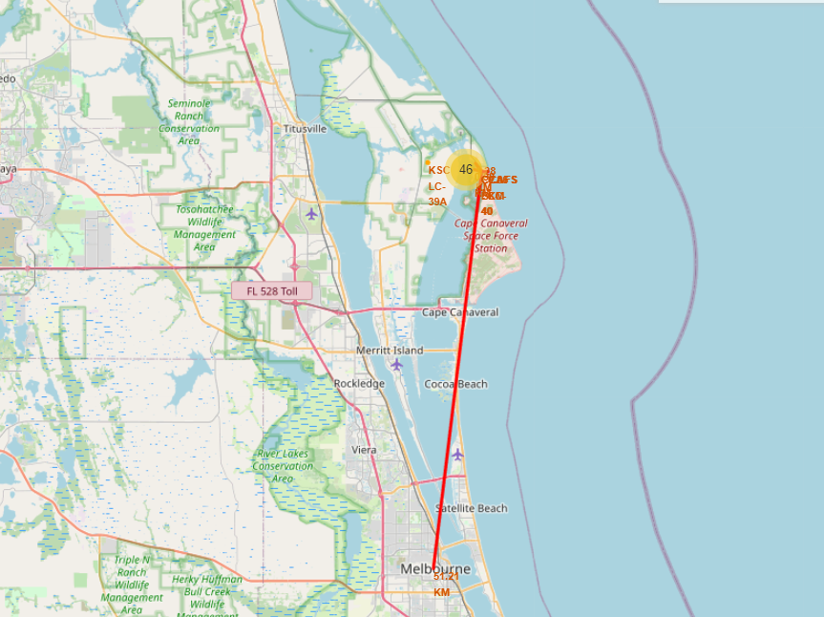
Distances from Launch Sites to Landmarks
Distance to Closet Railway
Distance to Highway
Distance to Coastline
Are launch sites in close proximity to railways? Yes
Are launch sites in close proximity to highways? Yes
Are launch sites in close proximity to coastline? Yes
Do launch sites keep certain distance away from cities? Yes
Distance to City

Slide 37
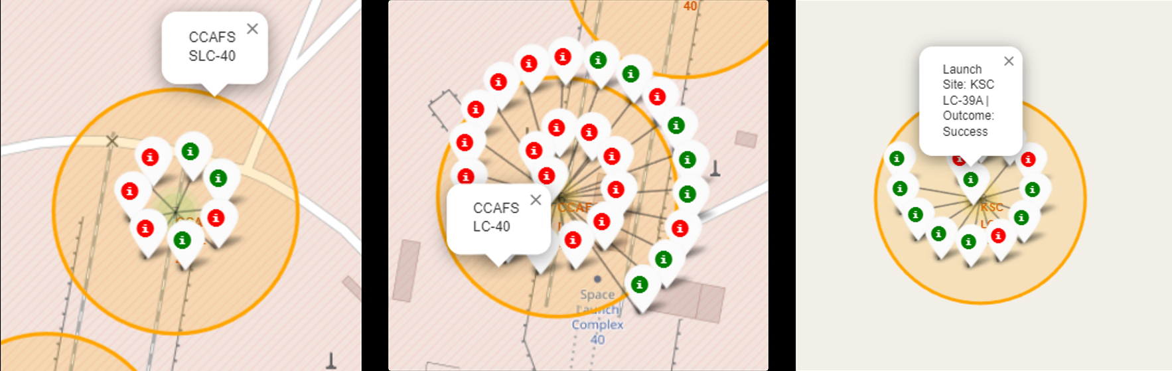
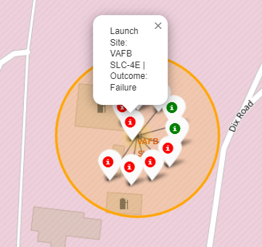
Markers displaying launch sites with color-coded labels
Green Marker shows Successful lunches and Red Marker shows Failure.
California Launch Sites
Florida Lauch Site

Slide 38

Section 4

Slide 39
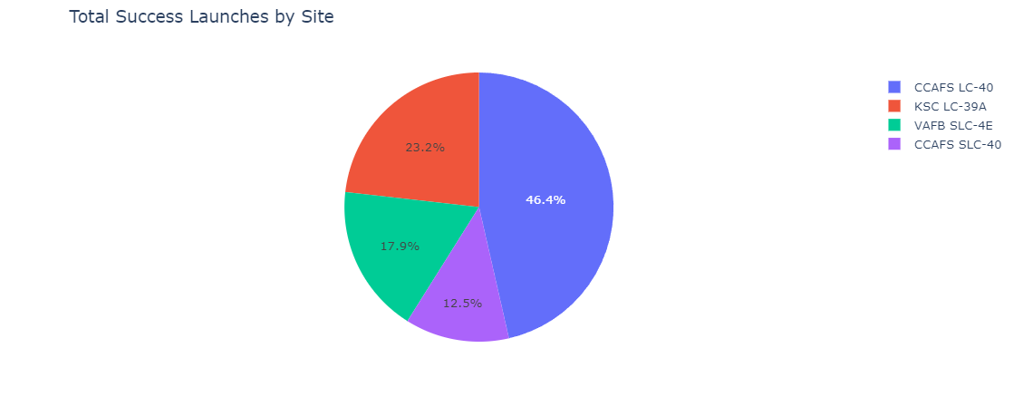
Pie Chart Illustrating Success Percentage for each Launch Site
We can see that KSC LC-39A had the most successful launches from all the sites.

Slide 40
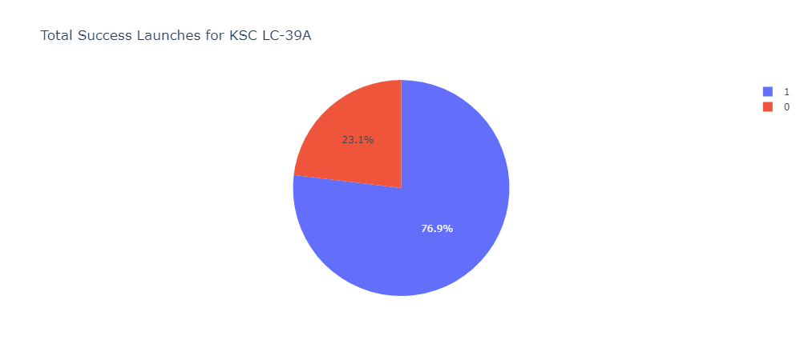
Pie Chart Illustrating Launch Site with the Highest Launch Success Ratio
KSC LC-39A attained a success rate of 76.9% and experienced a failure rate of 23.1%.

Slide 41
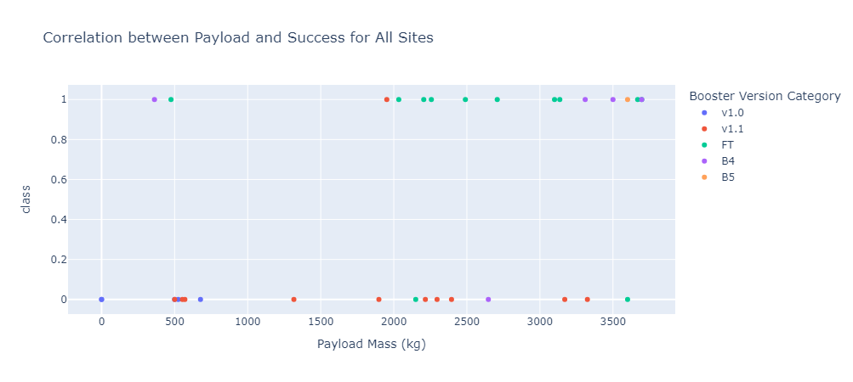
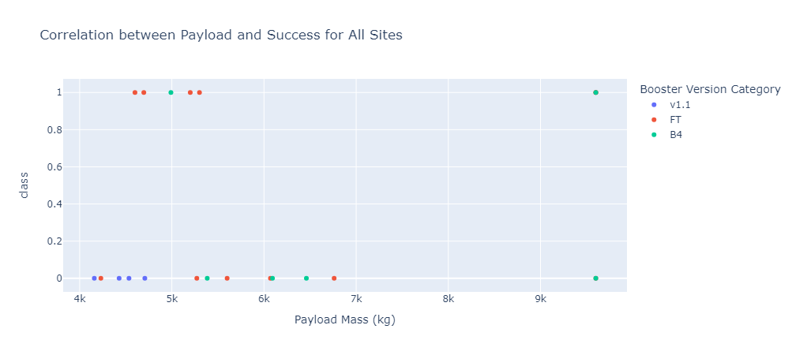
Scatter Plot of Payload vs Launch Outcome for All Sites, with Various Payloads Selected in the Range Slider
Low Weighted Payload (0-4000 KG)
Heavy Weighted Payload (0-4000 KG)
We can see that the success rate for low weighted payloads is higher than the heavy weighted payloads.

Slide 42

Section 5

Slide 43
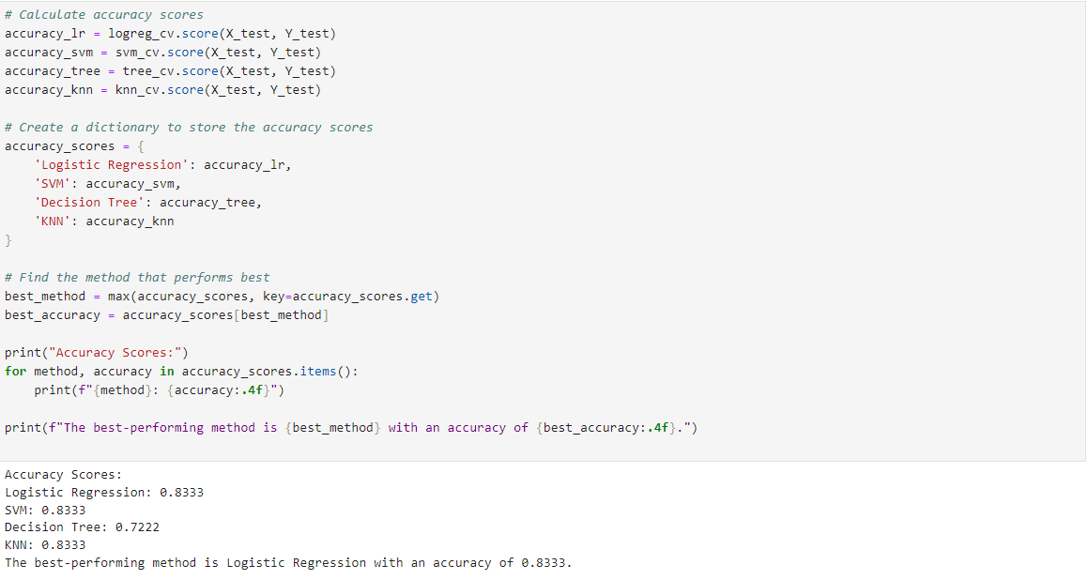
Classification Accuracy

Slide 44
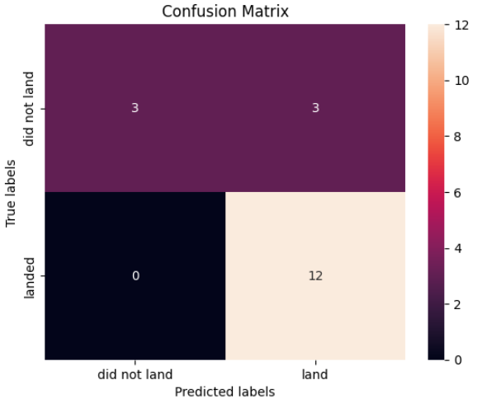
Classification Accuracy
Examining the confusion matrix, we see that logistic regression can distinguish between the different classes. We see that the major problem is false positives.

Slide 45
Conclusions
Based on our analysis, we can draw the following conclusions:
There appears to be a positive correlation between the number of flights at a launch site and the success rate.
The launch success rate exhibited an upward trend from 2013 to 2020.
Orbits ES-L1, GEO, HEO, SSO, and VLEO demonstrated the highest success rates.
KSC LC-39A emerged as the launch site with the highest number of successful launches.
Logistic regression proved to be the most effective machine learning algorithm for this specific task.

Slide 46


